Slide 1
Renishaw SEND Information Report 2024-2025
This report should be read alongside our SEND Policy (available at www.renishawprimary.org.uk)
Click here to go to the contents page
Published: November 2024
Review Date: September 2025

Slide 2
Key Contacts
Contents Page
Statement of Intent
What needs do
we cater for?
How do we know
if our pupils need extra help?
What will the school do to support my child?
Working Together to Identify Special Educational Needs
What should I do if I think my child has Special Educational Needs (SEN)?
How will we involve parents and carers?
How will we involve pupils with SEN in their education?
How will the curriculum be matched to my child’s needs?
Making every lesson count for all learners
What training do our staff have in order to support pupils with SEN?
Who will support my child in school?
How can I be involved in supporting my child?
What extra support could we provide and who will decide on the support?
What opportunities will there be for me to discuss my child’s attainment and progress?
How does the school know how well my child is doing?
How will the school prepare and support my child to join the school?
What support will there be for my child’s emotional and social well-being?
How will my child be included in activities outside the classroom, including trips?
How accessible is the school environment?
What if my child has Medical Needs?
What if my child needs support for behaviour?
Supporting pupils with SEN who are LAC/PLAC
Lincolnshire’s Local Offer
How can I access support for myself and my family?
What to do if you have concerns?
Appendix
CLICK ON THE PICTURE TO TAKE YOU TO THE PAGE

Slide 3
Key Contacts:
In the first instance, if you have any concerns that your child might have a Special Educational Need or is finding learning difficult you should contact your child’s Class Teacher. You can email info@renishaw.derbyshire.sch.uk or contact them on Class Dojo.
Our Special Educational Needs Coordinator (SENCo) is Mrs Rebecca Jones
(senco@renishaw.derbyshire.sch.uk)
Our SEN governor is Mrs Rebecca Williams.
The role of the SENCo involves ensuring that:
• teachers understand children’s needs
• teachers are trained in meeting those needs
• the quality of teaching for children with SEND, and provision across the
school is efficiently managed.
Address – Renishaw Primary School
Hague Lane
Renishaw
S21 3UR
Phone – 01246 432366
Email - info@renishaw.Derbyshire.sch.uk
Mrs Rebecca Jones
Mrs Rebecca Williams

Slide 4
Statement of Intent
Renishaw Primary School values all pupils and celebrates diversity of experience, interest and achievement. All pupils need to experience praise, recognition and success, and pupils with SEND have equal entitlement to this.
The school aims to:
• Eliminate discrimination.
• Promote equal opportunities.
• Foster good relationships between pupils with SEND and pupils without SEND.
The school will work within the following principles, which underpin our SEND Policy.
• The involvement of pupils and their parents/carers in decision-making.
• The identification of pupils’ needs.
• Collaboration between education, health and social care services to provide support.
• High-quality provision to meet the needs of pupils with SEND.
• Greater choice and control for pupils and their parents over their support.

Slide 5
What Special Educational Needs do we cater for? We cater for the four broad areas of SEN. These include:
Communication and Interaction (CI) | Cognition and Learning (CL) | Social, Emotional and Mental Health Needs (SEMH) | Sensory and/or Physical (SP)
Speech, Language and Communication Needs (SLCN) Autism Spectrum Disorder/Condition (ASD/ASC) | Moderate Learning Difficulties (MLD) Severe Learning Difficulties (SLD) Profound and Multiple Learning Difficulties (PMLD) Specific Learning Difficulties (SpLD) SpLD – dyslexia, dyspraxia and dyscalculia | Attention Deficit Disorder (ADD) Attention Deficit Hyperactivity Disorder (ADHD) Attachment Disorder (AD) | Hearing Impairment (HI) Multi-sensory Impairment (MSI) Visual Impairment (VI) Physically Disabled (PD)

Slide 6
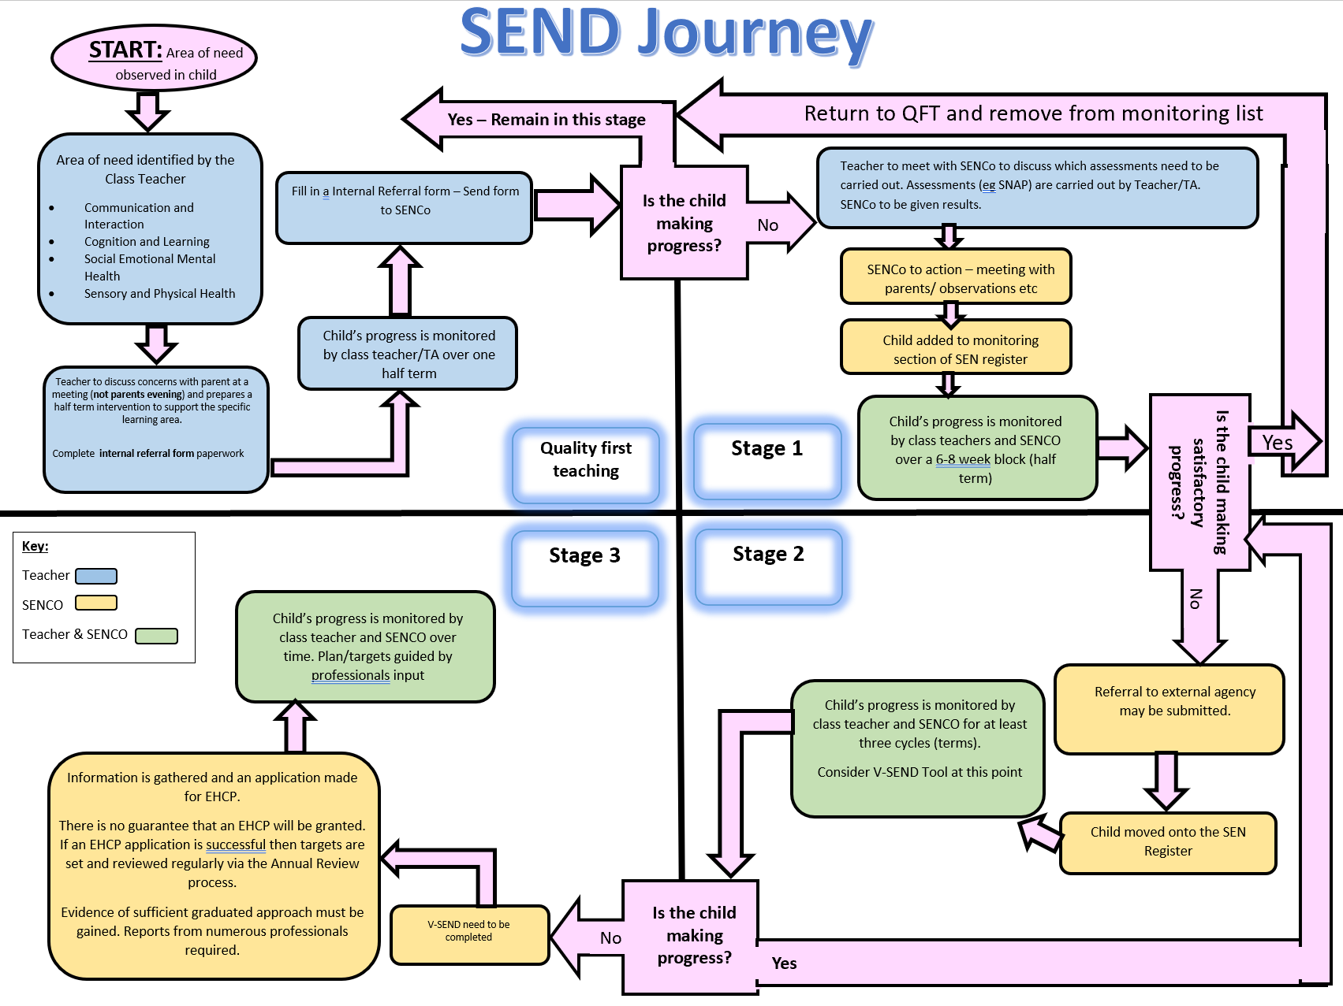
How do we know if our pupils need extra help?
Identifying SEND and the Graduated Approach:
The school has a clear approach to identifying and responding to SEND and recognises that early identification and effective provision improves long-term outcomes for the pupils.
Pupils are currently identified at Pupil Progress Meeting and via teacher concerns using an Internal Referral Form. This follows the SEND Journey Flow Chart. This will ensure that we are correctly identifying children with SEN and following the relevant pathways for each of them.
When a child is identified, the Assess, Plan, Do, Review process begins. The class teacher will add the child to the Pupil Learning Plan and begin extra support for the child. This will be monitored by the Class Teacher and the SENCo and next steps discussed.
Once a child has been identified as needing to be on the SEN Register parents/carers will be informed.
The school has a SEND Register and SEND Tracker. These are reviewed and updated by the SENCo on a regular basis.
See Appendix 1

Slide 7
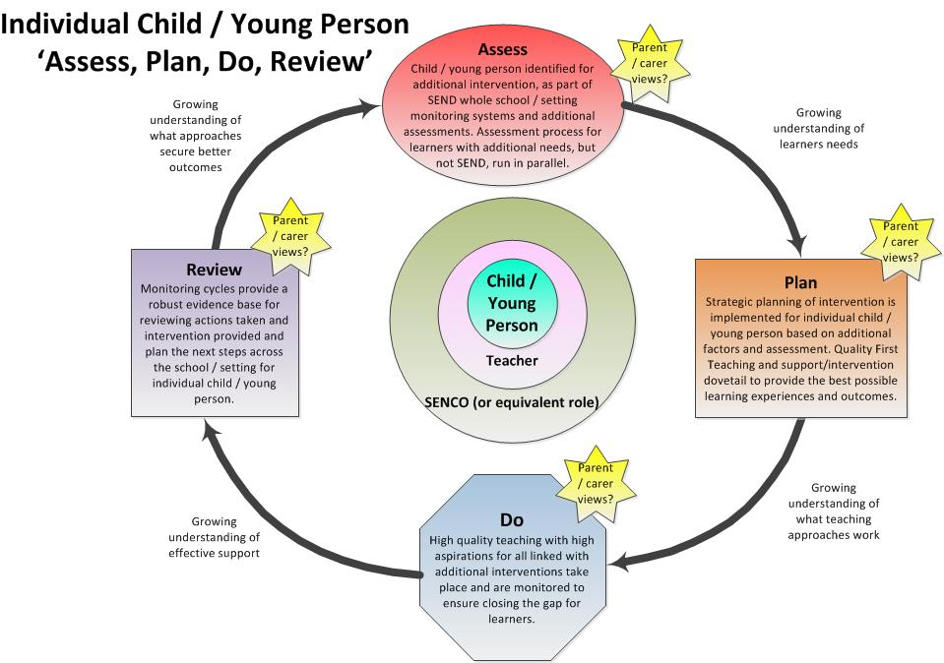
What will the school do to support my child?
Initially we will implement the agreed plan of action, making full use of the support available within the school.
Where necessary additional advice and support may be sought from external agencies.
Strategies and interventions will be in place to support the child as well as realistic short-term SMART (Specific, Measurable, Achievable, Relevant/Realistic, Time-bound) targets.
These will be reviewed through a cycle of ‘Assess, Plan, Do, Review’.

Slide 8
Working Together to Identify Special Educational Needs
Working with External Agencies
This could include a health diagnosis from a doctor or a diagnosis of a Special Educational Needs, such as Autism.
Working with Parents/Carers
If parents/carers have a concern about their child, we will listen and investigate.
Identifying SEN
Staff working with your child
Staff noticing that a pupil is requiring additional support with liaise with parents and the SENCo.
Working with other settings
We talk to previous settings to understand what support has been in place previously to help them to learn.
Pupils are defined as having Special Educational Needs when they require provision that is additional to and different from that which is available to all pupils.
Signs that we might look for:
Working below the expected level
Needing more time to complete learning
Needing extra equipment or tools to help with learning

Slide 9
What should I do if I think my child has Special Educational Needs (SEN)?
Parental Concerns Flow Chart
If you have concerns about your child’s progress, development , behaviour or mental health, arrange a meeting with your child’s class teacher.
Are there still concerns following the half term intervention or support given?
Yes
No
SEND team will observe your child and discuss next steps.
Continue normal monitoring and communication with the teacher.
At all times, High Quality Teaching with the class teacher is the best way for a child to make progress , but sometimes, a little boost can help realign learning.
Has progress been made?
Yes
No
SEND team to meet with teacher and parents to discuss strategies for learning and potential referrals to outside agencies
Teacher to continue to monitor and meet with parents (if needed) to review the learning and progress made

Slide 10
How will we involve parents and carers?
We strongly believe it is vital that parents/carers are involved with the support given and progress made by the child.
The SENCo and teachers are available to speak to parents/carers
The SENCo is available at Parents Evenings
Parents/Carers are invited to EHCP reviews
All parent/carers have access to Parent Mail and Class Dojo to keep up to date with information
We share Pupil Learning Plans and One Page Profiles with parents/carers

Slide 11
How will we involve pupils with SEN in their education?
‘I take part in a Pupil Voice’.
‘I can talk to any adult at school if I am worried about anything.’
‘ I talk to the adults around me about my learning.’
‘I have a personalised passport that all adults can see, so they know how to support me.’
‘I can share any worries using the class Worry Monster.’
Your child will be involved in the process of ‘Assess, Plan, Do and Review’ through talking to familiar adults about their work, identifying their strengths as well as aspects they find tricky. This often involves sharing classroom work and attending review meetings if appropriate.

Slide 12
How will the curriculum be matched to my child’s needs?
All children are well supported within the classroom by highly skilled teachers and teaching assistants. Appropriate adjustments are made to the classroom, teaching and resources to ensure that all children have access to the curriculum. These include:
collaborative learning (talking partners, mixed ability group work);
using ICT or a scribe to record;
using ICT to support learning;
using drama techniques;
using concrete apparatus (Numicon, magnetic letters);
the use of pupil’s interests;
targeted group work;
pre-learning of key points or vocabulary prior to a lesson;
1:1 support;
1:1 teaching;
interventions and guided work;
high quality phonics teaching;
the use of visual aids;
adaptation of the learning environment.

Slide 13
Making every lesson count for all learners
A qualified teacher who is able to teach pupils with SEN. Having learning set to meet their needs, so everyone can understand.
Having home learning that meets their needs.
Some pupils might require different equipment or learning strategies.
Supporting the teaching and learning of pupils with SEN
Pre teaching new vocabulary and highlighting key vocabulary in the lesson.
Teaching assistants are available to support with learning
Using visuals and objects to represent concepts.
Adaptive Teaching
(the process of including all children’s needs in learning)
Working in small groups or 1:1

Slide 14
What training do our staff have in order to support pupils with SEN?
Mrs Jones has BA(Hons) in Primary Education and has completed her National Award for SEN Coordination (NASENCO – PGCert in Education).
All staff members working with children receive regular contextual training with SEN.
Mrs Jones also works alongside individual staff on a regular basis to support with the specific needs of their class.

Slide 15
Who will support my child in school?
There are many individuals and groups of people (detailed below) who may be involved in providing support for your child.
Class Teacher
The Class teacher has overall responsibility for your child’s progress and will work with you and your child to ensure his/her needs are met. The Class teacher is the first point of contact should you wish to raise a concern about your child. It is the Class teacher’s responsibility to plan for teaching and learning and to make judgements based on your child’s progress.
SENCo
The SENCo will monitor the progress of all the children on the SEN register and will monitor the effectiveness of intervention for children throughout the school. The SENCo will lead review meetings, refer children to outside agencies when appropriate, liaise with other professionals and complete relevant paperwork.
Headteacher
The Head Teacher is in overall charge of all staff in school. The Head Teacher leads the termly pupil progress meetings, with SLT, and ensures that provision and support is available for children with SEN. The Head Teacher meets regularly with the SENCo to discuss provision in school for children with SEND.
Teaching Assistants
The Teaching Assistants support teaching and learning on a daily basis and have excellent knowledge of the children. They work with children 1:1 as well as in small groups and also deliver structured interventions with the guidance of the class teachers and SENCo.
Midday Supervisors
The Midday Supervisors support the personal, social and emotional needs of your child daily. Good communication between teaching staff and Midday Supervisors ensures that children are closely monitored during lunchtime and information is passed on if necessary.
Office Administrators
The Administrator will add your child’s special education need to the central record and provide clerical support when needed.
Governing Body
The Governing Body has a named Governor whose responsibility is to oversee the provision for SEN and feed information back to the governing body.
Outside Agencies
The school works with a range of Outside Agencies including Speech and Language Therapists, Specialist Teachers, Educational Psychologists, Physiotherapists, Paediatricians and outreach services. Their role is to support the child, family and school with all aspects of SEND.

Slide 16
How can I be involved in supporting my child?
You can support your child by:
engaging with the school;
attending meetings;
keeping the school up to date with any changes or information you feel is necessary to pass to the class teacher or SENCo;
attending parent workshops and open-school events;
supporting them with reading, spelling, times table and homework tasks;
providing home and wider learning opportunities

Slide 17
What extra support could we provide and who will decide on the support?
This will depend upon your child's individual needs. Each child's needs are unique and so each child will receive different support, depending upon their specific needs. The Special Educational Needs Co-ordinator (SENCo) and class teacher will decide which strategies and resources are appropriate to support your child's needs. Where outside agencies are involved, they will provide advice about how best to support your child's needs. Below are some examples of what the school can provide.
Communication and Interaction (Speech and Language)
Resources provided by the Speech and Language Therapy Service.
Communication and language games
Social skills games
Visuals (timetables, now & next)
Colourful semantics.
Social, Emotional and Mental Health
Emotional literacy strategies
Social skills games
Reward strategies
Playground buddies
Social Stories
Lunchtime clubs
Sensory and Physical Needs
Specialist equipment such as seating, writing slopes, pencil grips and calmers
Specialist training from outside agencies, such as physiotherapists for pupils with disabilities
Sensory Circuits to meet the individual sensory needs of a child
Cognition and Learning (Learning Need)
Different approaches to learning, e.g. visual, hands-on
Different work expectations, matched to the child's ability
Different/extra resources, e.g. word cards, number squares
Special Literacy or Numeracy programmes,
Extra adult support, group work, individual support

Slide 18
What opportunities will there be for me to discuss
my child’s attainment and progress?
We pride ourselves on our positive relationship with parents so if you have any questions about your child’s progress you can make an appointment to see your child’s class teacher at any time.
We report in detail to parents through Parents’ Consultation Evenings which are held twice a year and via the School Report in July. Permission will always be sought before your child is assessed by an outside agency, e.g. the Educational Psychologist, and feedback will be given as a written report or verbally as part of a review meeting.
Staff also love to share successes on an, as and when basis so will often catch parents at the beginning or end of the day to celebrate individual children’s achievements or progress. There are also numerous occasions throughout the year when parents are invited into school to see the children working and performing e.g. Open Mornings, Sports Day and Celebration Assemblies.

Slide 19
How does the school know how well my child is doing?
On entry to the Early Years Foundation Stage (YR) teachers baseline assess children in relation to the ‘Ages and Stages,’ EYFS document based on information from nursery settings, initial observations and some basic 1:1 assessments. At the end of the Foundation Stage, they are again assessed formally against the Early Learning Goals.
In Key Stage One and Two, children’s progress is tracked termly and measured against age-related expectations in relation to the National Curriculum. This process includes Pupil Progress Meetings between the class teacher, Headteacher and SENCo when children’s progress is discussed in relation to directing support and interventions appropriately. Formal national assessments take place at the end of Key Stage 2.
Assessments made by outside agencies are also utilised within the school.

Slide 20
How will the school prepare and support my child to join the school?
If your child is joining our school in to the EYFS class, we have a transition programme in place. Initially your child’s teacher will visit him/her in his/her early years setting (or at home if your child does not attend an early years setting). This is followed by 2 transition days during the Summer Term aimed at helping your child to become comfortable in his/her new surroundings. The children also receive their own Welcome pack which parents can share with them at home in preparation for the new term.
If your child joins the school in another year group, we plan, in consultation with parents/carers, the transition depending on the needs of the child. Your child is welcome to make visits to the school to meet their class and their teacher and familiarise him/herself with the school routines.
As with most things in school, these arrangements are extremely flexible and can be personalised and adapted to meet the particular needs of your child. There are also a number of set opportunities for parents to meet with staff in year group and 1:1 settings but again, further meetings can be arranged if necessary.
If a child is already identified as having special educational needs, it is usual practice for our SENCo to be invited to and attend a Nursery review meeting and for all paperwork to be forwarded to the school during the summer break.

Slide 21
What support will there be for my child’s emotional and social well-being?
The emotional and social well-being of your child is of great importance to us. Where appropriate, additional intervention (individual or small group) will be organised to help your child’s emotional and social development.
Teachers, Teaching Assistants and Midday Supervisors build up strong relationships with children to support their emotional needs.
The school rules, including rewards and sanctions, are used consistently to support children’s behaviour.
We work closely with outside agencies to support children with emotional and behavioural needs.
All safeguarding and child protection issues will be reported via CPOMS to the Head Teacher and Designated and Deputy Designated Safeguarding Leads.
PSHE is considered an important subject taught weekly and a PSHE Scheme of work is used across the whole school.
Emotional well-being interventions may be used to support children on a regular basis for a length of time, alongside outside agencies when needed.
Where appropriate, a Nurture/ELSA provision is available to support children with their SEMH needs.

Slide 22
How will my child be included in activities outside the classroom, including trips?
The school will endeavor to ensure that provision is put in place so that all children can access after school activities, breakfast clubs, outdoor learning and educational visits including residential opportunities.
Where necessary, we will endeavour to ensure that specialist support is available and if required, reasonable adjustments made to enable all children to access the provisions on offer, wherever possible.

Slide 23
How accessible is the school environment?
At Renishaw Primary the school is mainly accessible to wheelchairs and there is an accessible toilet/changing area within the EYFS block.
There are also two disabled parking spaces available in the on-site carpark.
We are an actively inclusive school and will always make reasonable adjustments, where possible, for any visitors who may have a disability.

Slide 24
What if my child has Medical Needs?
If your child has specific medical needs, then please contact the SENCo directly or via the office. The SENCo will ensure that appropriate plans can be put into action.
If needed, a ‘care plan’ can be developed, with support and advice from outside agencies, to inform all staff of the specifics of the condition and what should be done to support the needs of the child.
If your child requires ongoing medication, please contact the school office for more information.

Slide 25
What if my child needs support for behaviour?
All children at school follow the school behaviour policy.
From time to time, we have children who require additional and personalised support with their behaviour, in these circumstances we will put together a Positive Behaviour Plan with staff and parents. The processes in our Behaviour Policy may not work for the child therefore the Behaviour Management Plan will supersede.
We will work with you and your child and we may also suggest working in partnership with outside agencies to find the best strategies to support your child.

Slide 26
Supporting pupils with SEN who are LAC/PLAC
If a pupil is LAC/PLAC and has SEN, the SENCo will review their Personalised Learning Plan (PLP) and care plans for the pupil.
If appropriate, the Virtual School Head will be invited to comment on proposal of SEN support as part of our Graduated Approach.
The SENCo and LAC Coordinator will work together to ensure that the whole – school is working together to ensure that the right support is given.
Please read our Looked After Children Policy for more details.
Our LAC Coordinator is Mr Fuller.

Slide 27
Derbyshire’s Local Offer
You can find Derbyshire’s SEN Local Offer here.
SEND Local Offer – Derbyshire County Council
This is an online resource provided by each local authority in the UK, outlining the support and services available for children and young people with SEND and their families. It includes information on education, health, social care, and other services, helping families understand what support they can access, how to get it, and how services work together to meet individual needs. The Local Offer aims to improve transparency and empower families by making it easier to find the right support.

Slide 28
How can I access support for myself and my family?
Young Minds www.youngminds.org.uk - Young Minds: The voice for young people’s mental health and wellbeing | Kids.org www.kids.org.uk – working with disabled children, young people and their families
Derbyshire County Council www.derbyshire.gov.uk – provides information on the local offer, local schools and information for parents including links to support groups. Find links here for 4all – a magazine with up-to-date information on SEND and activities for children, young people and families. Also find links here for short breaks for children and young people with SEND | Families Information Services: provides free, impartial information and guidance. It is for parents, carers, practitioners, children, and young people. The information covers a range of services, activities, and events available in Derbyshire. Email: info.fis@derbyshire.gov.uk Telephone: 01629 535793 (9am to 5pm, Monday to Friday) Follow FIS on Facebook
Derbyshire Information Advice and Support Service (DIASS) - Provides independent information, advice and support to children and young people with special educational needs and disabilities (SEND), as well as their parents and carers. Email: ias.service@derbyshire.gov.uk Telephone: 01629 533668 Monday to Friday from 9:30am to 3pm. | Derbyshire Parent Carer Voice (DPCV) is a registered charity, run by parent/carer volunteers with children/young people with special educational needs and/or disabilities. We organise parent participation, providing the opportunity to talk about all the services they receive in Derbyshire. https://derbyshireparentforums.co.uk/
Dads’ Social Support Group A new group aimed at dads of children on the autism spectrum, though the children do not have to have a diagnosis for the dads to be able to attend. Email: steve.mckinley@aem.org.uk | Family Lives: provides targeted early intervention and crisis support to families. Email: askus@familylives.org.uk Telephone: 0808 800 2222
Neurohub – Neurodivergence Thrives Here – Chesterfield – Support Hub Email: becky.hague@fair-play.co.uk Telephone: 01246 203963 Mobile: 07874 941890 | Child Bereavement UK – support to rebuild lives when a child grieves or in cases of child loss. https://www.childbereavementuk.org/ Telephone: 0800 02 888 40

Slide 29
What to do if you have concerns?
Speak to your child’s class teacher either on at the door to arrange an appointment or get in touch by calling on 01246 432366 or email info@renishaw.derbyshire.sch.uk
We hope that complaints about SEND provision will be rare; however, if there should be a concern the process outlined in the school’s Complaints Policy should be followed.

Slide 30
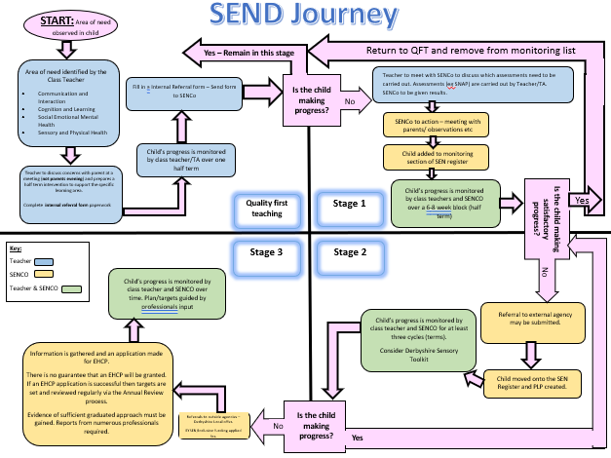
Appendix 1:

